Slide 1
Malware

Slide 2
Today’s Plan
09:00 – 10:00: MALWARE (William Stallings, Lawrie Brown, Computer Security Principles and Practice [Chapter 6], Third edition, Pearson, Australia).
Definition.
Propagation methods.
Types of payload.
10:00 – 10:30: Demo.
10:30 – 11:00: Coursework Questions and VMs Sharing.
11:00 – 12:00: Lab 7 (Spreading Python Malware using a SSH Linux Connection).

Slide 3
What is Malware?
www.menti.com

Slide 4
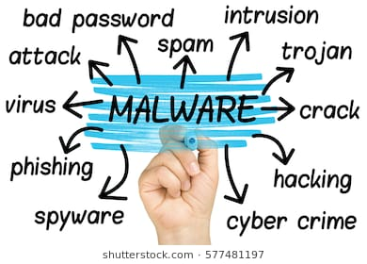
Definition and Types
Malicious Software
A program that is inserted into a system (usually unsuspectedly) with the intend of compromising the system’s requirements.
Examples?
Types:
Parasitic: Cannot exist independently (virus, logic bombs, backdoors).
Independent: Self-contained and can be scheduled to run by OS (worms, bots).

Slide 5
Propagation Mechanisms

Slide 6
Propagation Mechanisms
Infection of existing files.
Viruses
Exploitation of vulnerabilities.
Worms
Social engineering attacks to bypass security mechanisms.
Trojans
Blended attacks (multiple methods of propagation).
Advanced Persistent Threats (careful target selection).
Notes:
-APT technically is not a mechanism but a strategy.

Slide 7
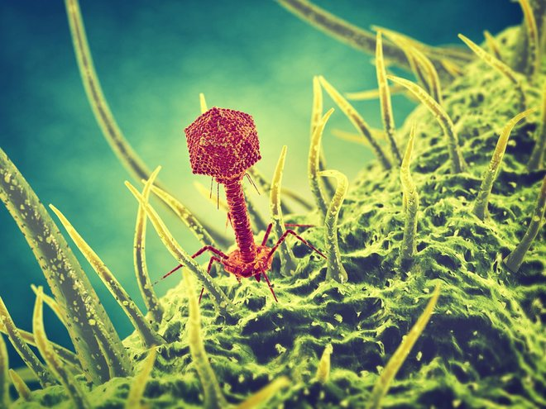


Infecting Files (Virus)
Computer program that can infect other programs by modifying them to include a (possibly evolved) version of itself.
Components:
Infection mechanism
Trigger/Logic bomb
Payload
Phases:
Dormant
Propagation
Triggering
Execution
Notes:
-Infection mechanism: Infection vector where a virus has a search routine, localises new files in disk for infection.
-Trigger: Compiled version that could be activated any time an executable file has some conditions met.
-Payload: Actual body or data that performs the malicious purpose.
-Dormant: Idle. Malware has accessed but doesn't take action until triggered.
-Propagation: Places a copy into other files/areas of the disk. Morphs to avoid detection
-Triggering: Virus is activated to perform intended function (counter).
-Execution: The function is performed (message in screen, file damaging).

Slide 8
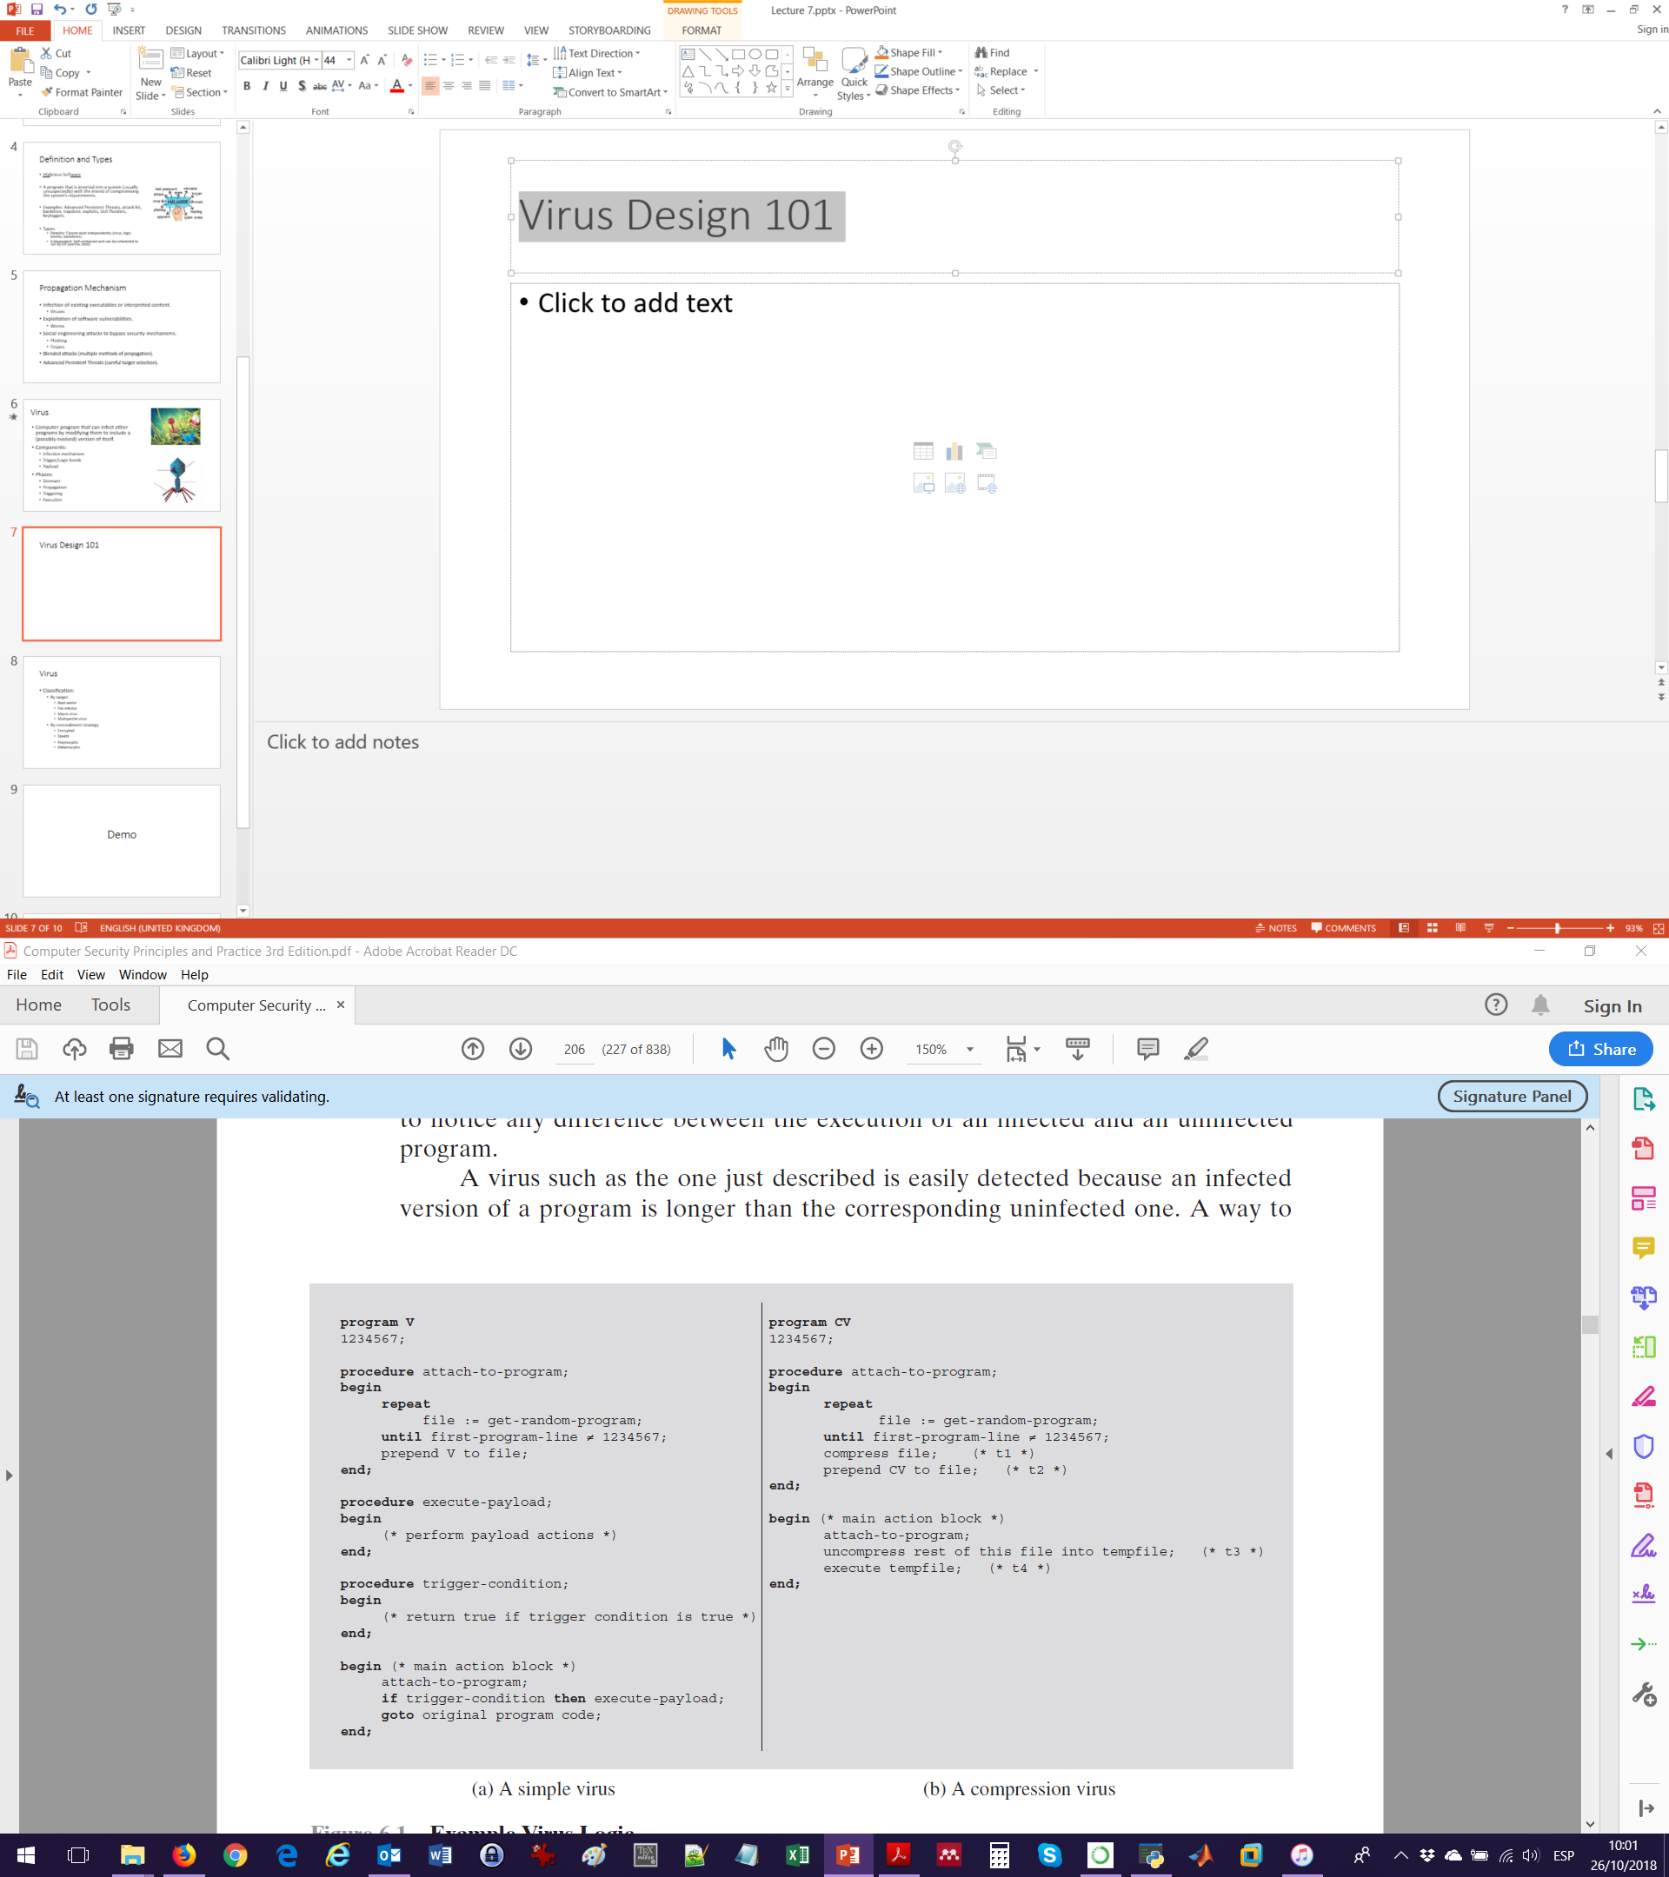
Virus Design: Simple
Set a marker.
Seek for uninfected files.
Establish the trigger conditions.
Define the payload actions.
Main action block.
Easiest way to detect these type of viruses?
Notes:
-An infected version of a program is longer tan the uninfected one. This can be noticed by almost any SW executing the program.

Slide 9
Virus Design: Compressed
Compress the .exe so that both the infected and uninfected versions are of identical length.

Slide 10
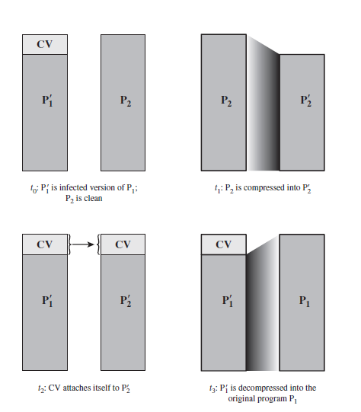
t0: A program P1 is evoked, but its infected version P1’, which contains the code of the virus (CV), is run.
t1: For each uninfected file P2, the virus compresses that file to produce P2’ (shorter than the original by a factor of the size of CV).
t2: A copy of CV is prepended to P2’.
t3: The compressed version of P1, P1’, is uncompressed.
t4: P1 is executed.

Slide 11
Virus Classification
By target
Boot sector infector
File infector
Macro virus
Multipartite virus
By concealment strategy
Encrypted
Stealth
Polymorphic
Metamorphic
Notes:
-Boot sector infector: Infects a master boot record and spreads when system is booted from the disk containing virus.
-File infector: Infects files that the OS or shell considers to be executable.
-Macro virus: Infects files with macro or script interpreted by application.
-Multipartite: Infects in multiple ways.
-Encrypted virus: Uses encryption to obscure its content. Virus creates key and conceals it in virus. When infected program is evoked, virus uses key to decrypt. As virus replicates, different keys are used (this varies the pattern).
-Stealth: Hide the entirety, not only the payload (code mutation, compression, rootkit).
-Polymorphic: Creates functionally equivalent copies at the propagation phase. Vary the signature by changing order of superfluous instructions (mutation engine). Can also use encryption.
-Metamorphic: Rewrites itself completely after each iteration. They may change not only appearance, but also behaviour.

Slide 12
Macro virus
Platform and hardware independent.
Infects documents, not executables.
Easily spread (e-mail).
Could file access control be used to prevent their propagation?
Notes:
-Yes because with sufficient restrictions then a world user may be protected, but users are expected to have –rwx privileges with the files and thus they will eventually propagate.

Slide 13

Vulnerability Exploits (Worms)
Worm: Self-replicating computer program that (typically) uses a network to send copies of itself to other nodes and does so without any user intervention.
Means to access a remote system:
Email or instant messenger facility.
File sharing.
Remote execution capability.
Remote file access or transfer capability.
Remote login capability.
Notes:
-Electronic mail or instant messenger facility: A worm e-mails a copy of itself to other systems, or sends itself as an attachment via an instant message service, so that its code is run when the e-mail or attachment is received or viewed.
-File sharing: A worm either creates a copy of itself or infects other suitable files as a virus on removable media such as a USB drive; it then executes when
the drive is connected to another system using the autorun mechanism by exploiting some software vulnerability, or when a user opens the infected file on the target system.
-Remote execution capability: A worm executes a copy of itself on another system, either by using an explicit remote execution facility or by exploiting a program flaw in a network service to subvert its operations.
-Remote file access or transfer capability: A worm uses a remote file access or transfer service to another system to copy itself from one system to the other, where users on that system may then execute it.
-Remote login capability: A worm logs onto a remote system as a user and then uses commands to copy itself from one system to the other, where it then executes.

Slide 14
Target Discovery
Scanning/Fingerprinting: Worm searches for other systems to infect.
Types:
Random: Testing random ip addresses.
Hit-List: Attacker compiles a list of potentially vulnerable machines (slow).
Topological: Uses information contained on an infected machine.
Local Subnet: If a worm passes a firewall and infects a host, then looks for targets in the local network.

Slide 15
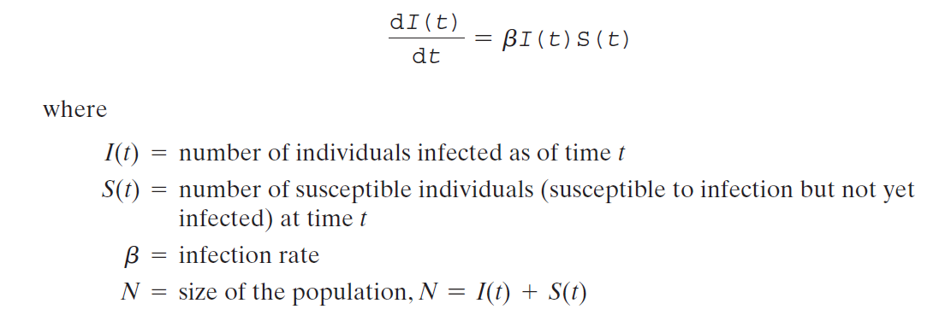
Rate of Propagation
Based on classic epidemic models from health sciences:

Slide 16
Social Engineering (Trojans)
Tricking users to assist in the compromise of his own system or personal information.
Widely used thanks to the explosive growth of the Internet and spam e-mail.
Notes:
-90% of email traffic is SPAM!

Slide 17

Trojan Horses
(Apparently) useful program containing hidden code.
Gain access to sensitive data.
What is the difference with respect to Virus/Worm?
Notes:
-A Trojan usually has a deceiving message i.e. claim to be an update or an email.
-It is also typically focused on obtaining something specific rather than on replicating.

Slide 18
Types of Trojans
Continuing to perform the function of the original program and performing a separate malicious activity.
Continuing to perform the function of the original program but modifying the function to perform malicious activity.
Performing a malicious function that completely replaces the function of the original program.

Slide 19
Types of Payload

Slide 20
Types of Malicious Payload
Data destruction:
Chernobyl virus (1998).
Data kidnapping (ransomware):
WannaCry
Real-world damage:
STUXNET
Logic bombs:
Alter or delete data.
Cause a machine halt.
Other damage.
Notes:
-Chernobyl infects .exe when opened. When a trigger date is reached, deletes data on the infected system by overwriting the first 1Mb of the hard drive with zeroes.
-WannaCry infected 230’000 computers worldwide asking for $300 per computer, otherwise deleting all encrypted files.
-Tim Lloyd convicted of setting a bomb that cost $10 M to his former employer, Omega Engineering. The “bomb” deleted files from the Company 20 days after he left.

Slide 21


Bots/Zombies
Malware subverts the computational and network resources of the infected system for use by the attacker (botnet).
Uses:
Distributed denial of service (DDoS) attack.
Spamming.
Sniffing traffic.
Keylogging.
Spreading new malware.
Installing add-ons ad browser helper objects (BHOs).
Attacking the Internet Relay Chat (IRC) network.
Manipulating online polls/games.
Notes:
-BHOs: Set a fake web with adds & negotiate a payment by clicks.
-IRC Clone attack: The controller orders each bot to connect a large number of clones. Victim is flooded by service request (like DDoS).

Slide 22
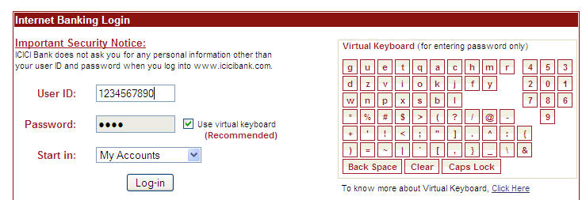
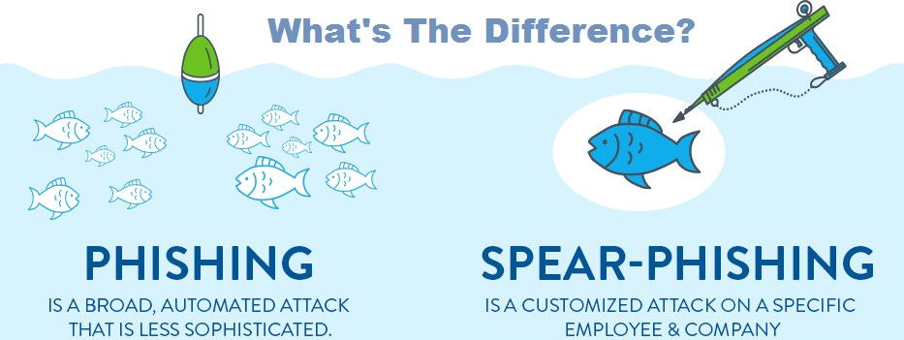
Information Theft
Payloads where the malware gathers data.
Most common target: Username/Password.
Keylogger:
Capture keystrokes on the infected machine.
Filtering to receive only important strokes.
Spyware:
Monitors activity.
Phishing:
Mimic a website to obtain data.
Spear-phishing: Tailor-made e-mail which increases the chance to fall in the attack.

Slide 23

Stealthing
Maintain a persistent and undetectable presence on the machine.
Purpose: Create a backdoor/trapdoor (mechanism that bypasses a normal security check).
Backdoor/trapdoors are common in SW practice (i.e. debug, maintenance).

Slide 24
Rootkit
Set of tools/programs installed to maintain covert access and used after attacker has broken into a system (gained unauthorised root privileges).
Types:
Persistent.
Memory-based.
User mode.
Kernel mode.
Virtual machine based.
External mode.
Notes:
-Persistent: Active each time system boots. (stored in registry or system file). Easy to detect by scanning copy.
-Memory based: Cannot survive reboot, its only in memory so harder to detect.
-User mode: Intercepts calls to Application Program Interfaces and modifies returned results.
-Kernel mode: Intercepts calls to native APIs in kernel mode (portion f OS that includes the most critical portions of SW).
-VM: Installs a light VMM, and runs the OS in a VM above it.
-External mode: Malware is located outside the normal operation (BIOS, system management) where it can directly access HW).

Slide 25
Kernel Mode Rootkit
Implementation of system calls in Linux.
Each system call is assigned a unique syscall number.
When a user-mode process executes a system call, process refers to it by the number.
Kernel maintains a system call table with one entry per routine (i.e. a pointer).
How to change system calls?
Modify system call table targets.
Modify the system call table (e.g. knark).
Redirect the system call table.

Slide 26
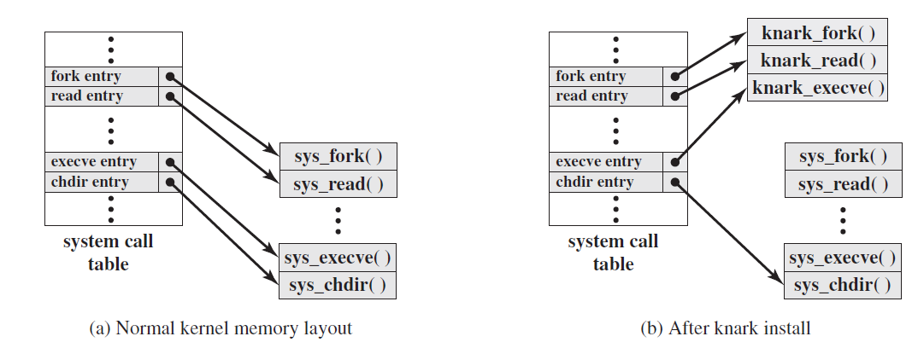
Kernel Mode Rootkit Attack (knark)
Notes:
-fork(): Create processes. Returns a process id (new) becoming the child of the caller.

Slide 27
Demo

Slide 28
Lab 7: Spreading Python Malware using a SSH Linux Connection

